Slide 1
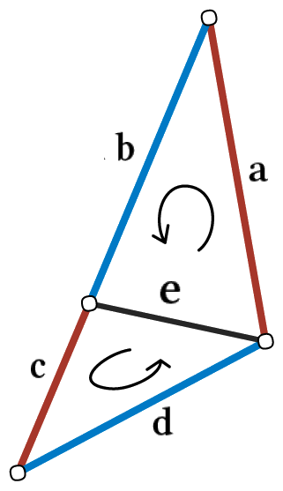
MeshCNN: A Network with an Edge
读书汇报
21951423
曾志通
Rana Hanocka, Amir Hertz, Noa Fish, Raja Giryes, Shahar Fleishman and Daniel Cohen-Or

Slide 2

CNNs on Images
Great for Classification & Segmentation
Notes:
Convolutional Neural Networks (CNNs) are a class of deep neural networks which are used to analyze visual data. In recent years, using CNNs on images has demonstrated outstanding performance on a variety of tasks such as classification and semantic segmentation

Slide 3


Image
Dense & uniformly sampled on a grid
Notes:
Grids:
Fixed number of convolutional neighbors
There is an order

Slide 4
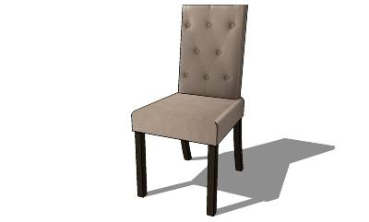
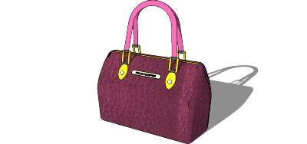
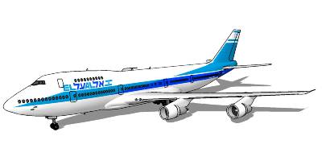
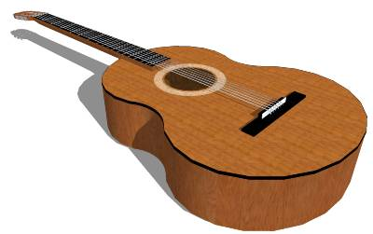
Our World is 3D
Notes:
Everything around us is complex 3D geometry
3d deep learning is of rising interest for industries related to robotics, autonomous driving

Slide 5
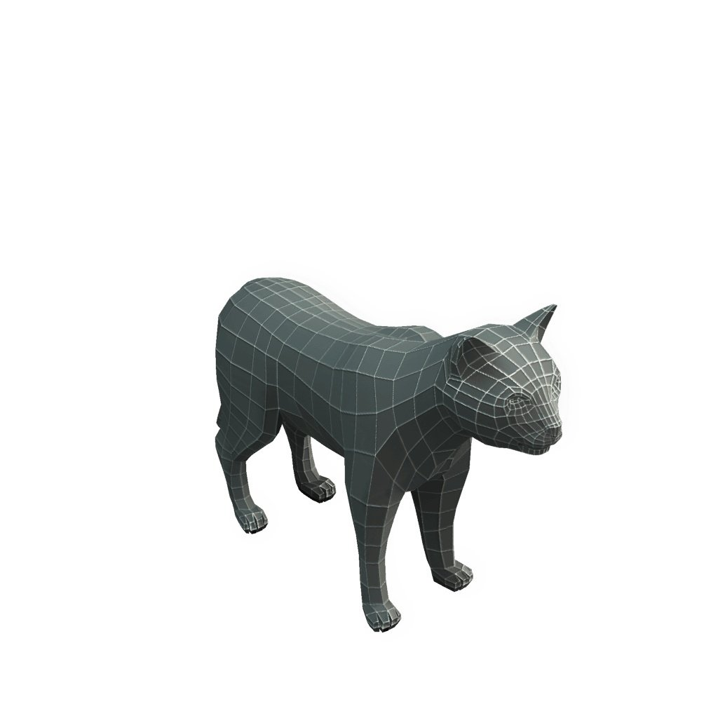
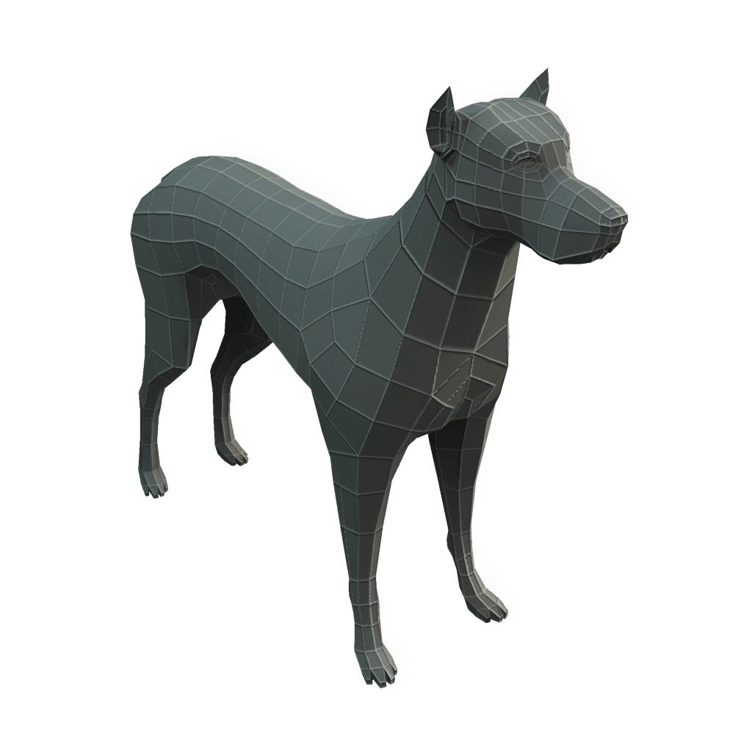
3D Deep Learning
Classification & Segmentation on Shapes
Notes:
In 3D deep learning, we also train neural networks to classify and segment 3D shapes. The problem is 3D shapes are inherently irregular. It makes operations like, convolutions non trivial!

Slide 6
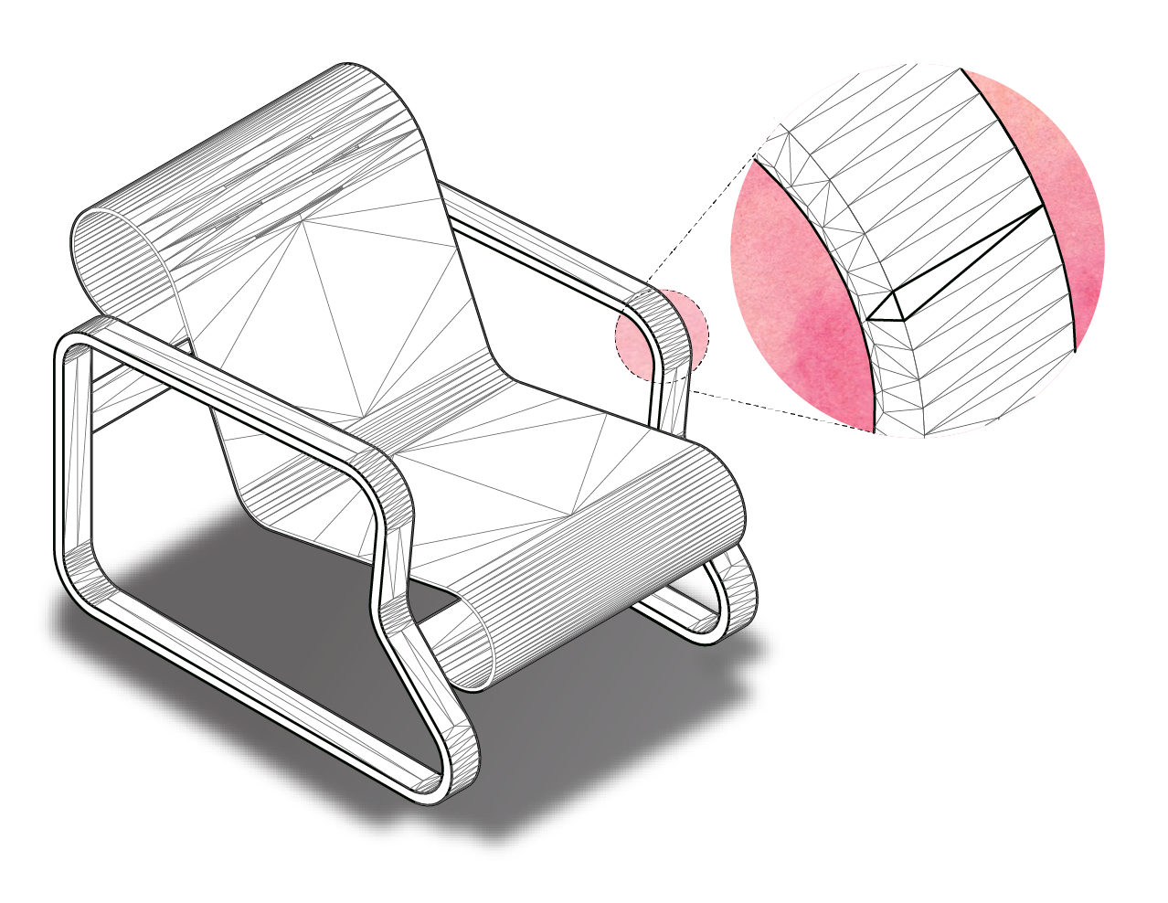
Mesh
Sparse, irregular & non-uniform
Notes:
In this work we want to build a CNN directly on meshes

Slide 7
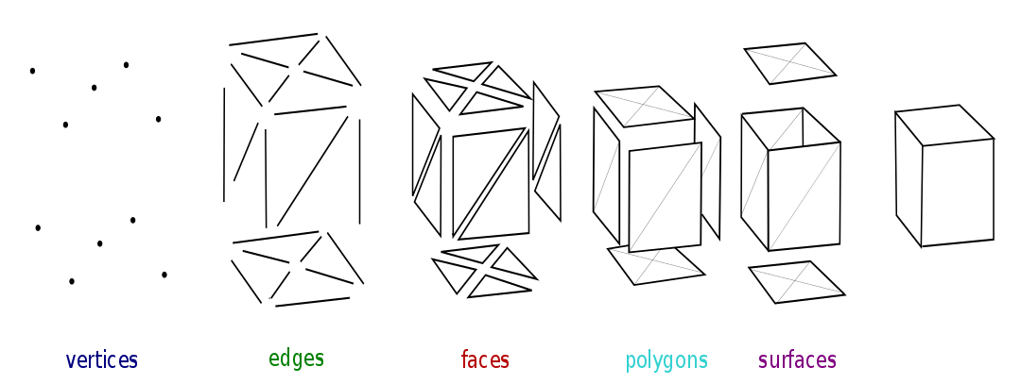
Mesh
Representation
Vertices
<x, y, z>
Edges
<vi, vj>
Faces
<vi, vj, vk>
Notes:
Meshes are a list of vertices, edges and faces, which together define the shape of the 3D object. The problem is that every vertex has a different # of neighbors, and there is no order.

Slide 8
Meshes are Irregular
Adapt to the surface
Large polygons in flat regions
Small polygons in detailed regions
Non-Uniform & Efficient

Slide 9
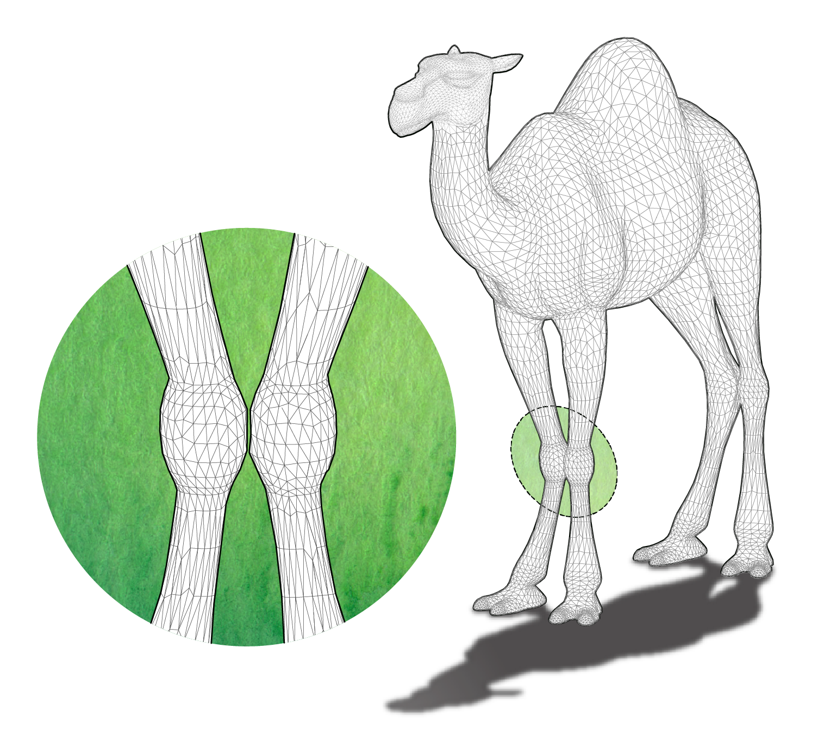
Meshes contain Topology
Accurate portrayal of shape structure
Geodesic proximity
Disambiguate nearby surfaces

Slide 10
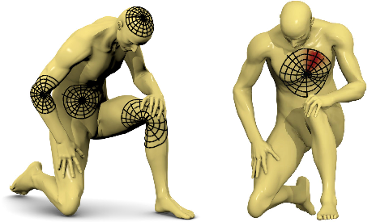
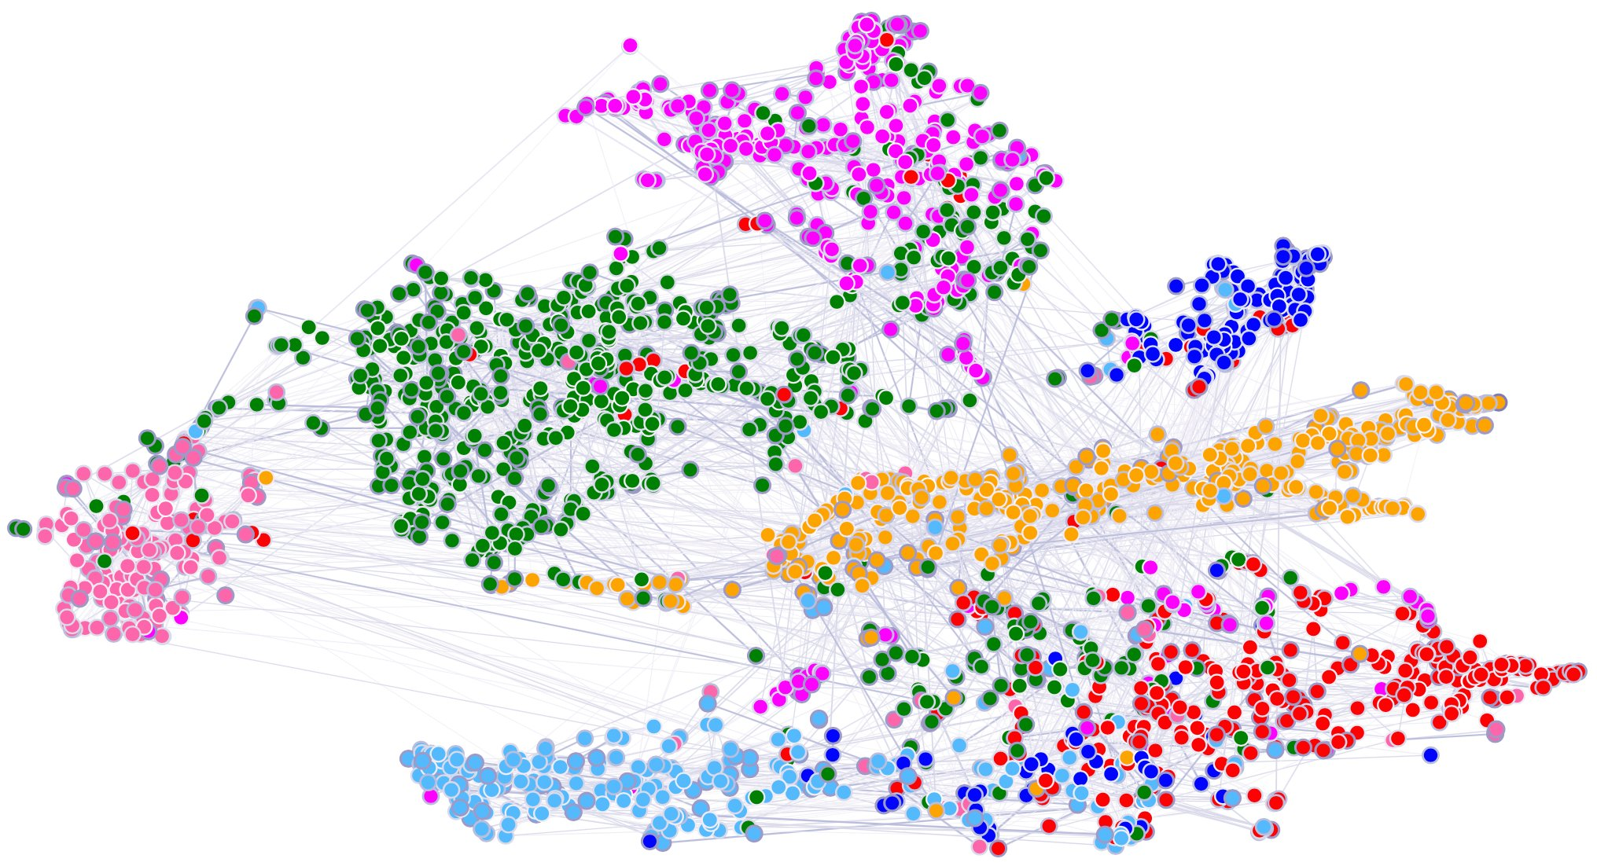
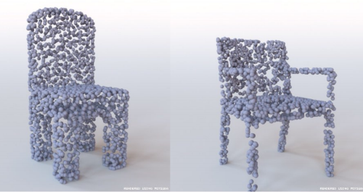
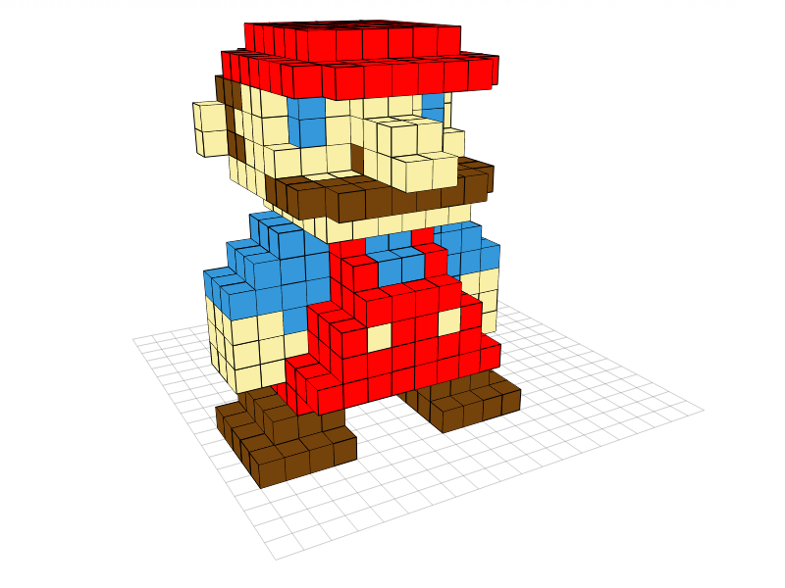
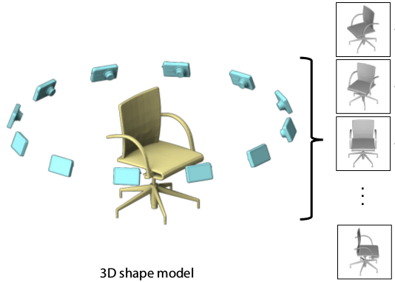
3D Deep Learning
Indirect
Direct
Multi-View
MVCNN [Su et al. 2015]
Graphs & Manifolds
[Boscaini et al. 2015]
[Maron et al. 2017]
Volumetric
Shapenets [Wu et al. 2015]
Point Cloud
PointNet [Qi et al. 2017]
PointCNN [Li et al. 2018]
Notes:
INDIRECT
mapping 3D shapes to multiple 2D projections -> regular image CNNs
Converting a 3D shape into a binary voxel grid -> 3D conv, etc.
Needs lots of memory, and wasteful or redundant CNN computations (e.g., conv on unoccupied voxels)
DIRECT
Representation which is ‘more direct’ to the underlying surface
Manifolds -> parametrize the shape to 2D patches and then use CNNs
Robust to articulations.. Smooth surfaces.. Less suitable for man-made shapes
Graphs
-> built for data in graph form such as social networks, or genetic data
-> work on vertices
Points
-> straight forward representation
-> does not contain topology or surface structure
Our work, unlike previous works
proposes (i) a convolution on the edges of a mesh
and (ii) a learned mesh pooling operation that adapts spatially to the task

Slide 11
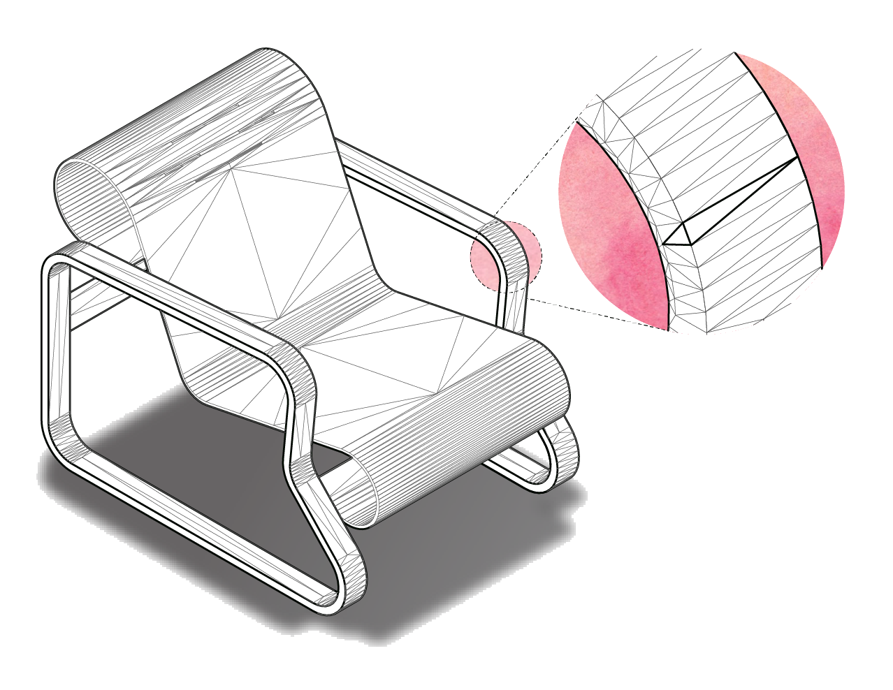
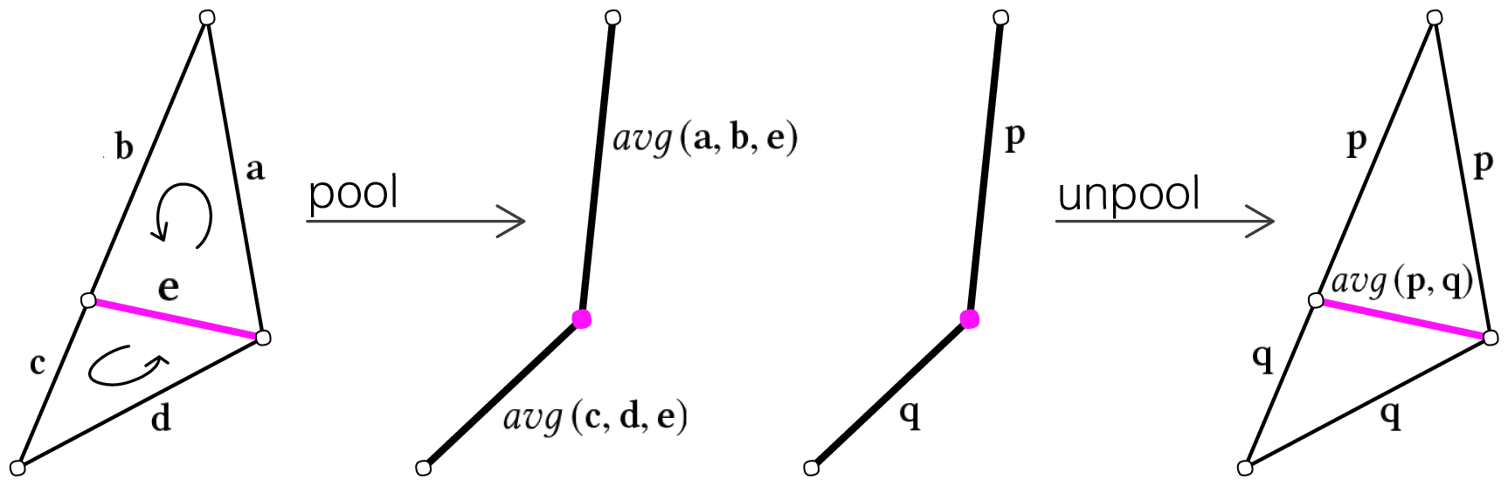
Goal: CNN directly on the irregular mesh elements
Mesh Convolution
MeshCNN
Mesh Pooling
Notes:
MeshCNN is convolutional neural network designed specifically for triangular meshes, which operates directly on the mesh edges.
We choose mesh edges, rather than vertices, because of the fixed size 1-ring neighborhood.

Slide 12
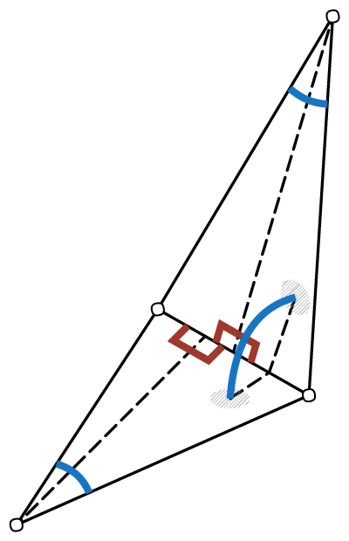
Input Edge Features
Relative Geometric Features
Invariant to similarity transformations
5-dimensional vector

Slide 13
Refresher: Image Convolution
Just a dot product
Kernel & Image Spatial Support
Consistent # conv-neighbors
Translation equivariant

Slide 14
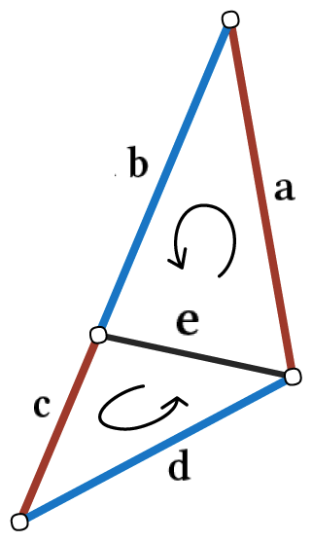
Mesh Convolution
Face normal
Consistent ordering in each face
Two valid orderings
(a, b, c, d) or (c, d, a, b)
How to handle ambiguity?
Notes:
Face normal defines consistent ordering, since vertices are ordered CCW

Slide 15
Mesh Convolution
Build symmetric features
e-> (a+c, |a-c|, b+d, |b-d|)
Conv Filter
(k₀, k₁, k₂, k₃, k₄)

Slide 16
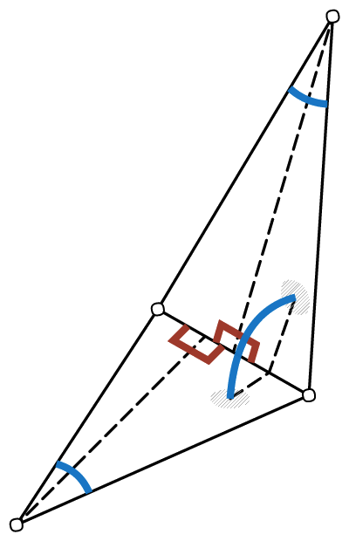
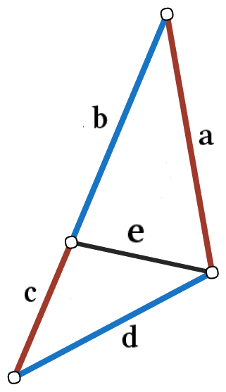
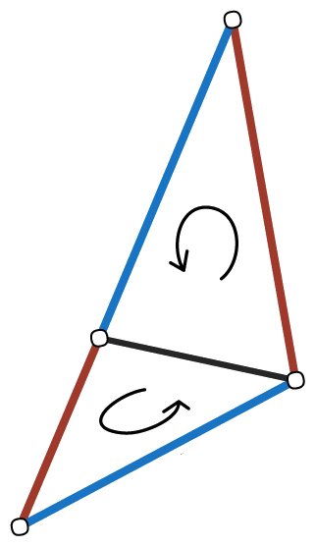
Recap
Geometric
Features
Invariant Convolution
1-ring neighbors

Slide 17
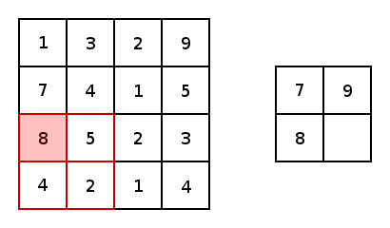
Refresher: (Image) Pooling
Reduce resolution of feature activation maps
Strengthens learned representation
Conv & Pool -> Translation Invariance

Slide 18
Generalized Pooling
Three core operations
Define pooling region; use adjacency
Merge features in each pooling region
Redefine adjacency for merged features

Slide 19
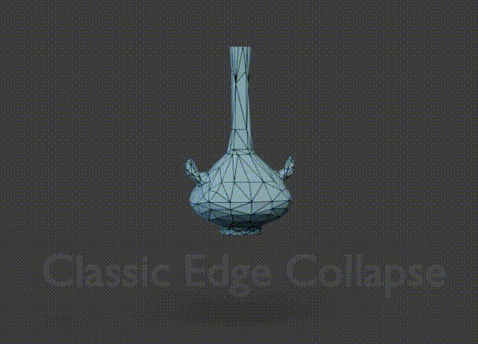
Refresher: Mesh Simplification
Traditional Mesh Simplification (Geometric)
Reduce information but keep shape
Edge Collapse
Iteratively remove edges

Slide 20

Learned Edge Collapse
Network decides collapse
Strengthens the learned representation
Visual insights from network
Notes:
The classic edge-collapse preserves the original shape by removing edges with a minimal geometric distortion. But, mesh pooling delegates which edges to collapse to the network, by deleting edges with the smallest feature activations.
Learning which edges to collapse has two main advantages. First, it strengthens the learned feature representation, by eliminating less informative features.
Second, it enables us to visualize what the network has learned. This provides useful insights into model interpretability and generalization, and gives better clues about robustness to real-world use cases.

Slide 21
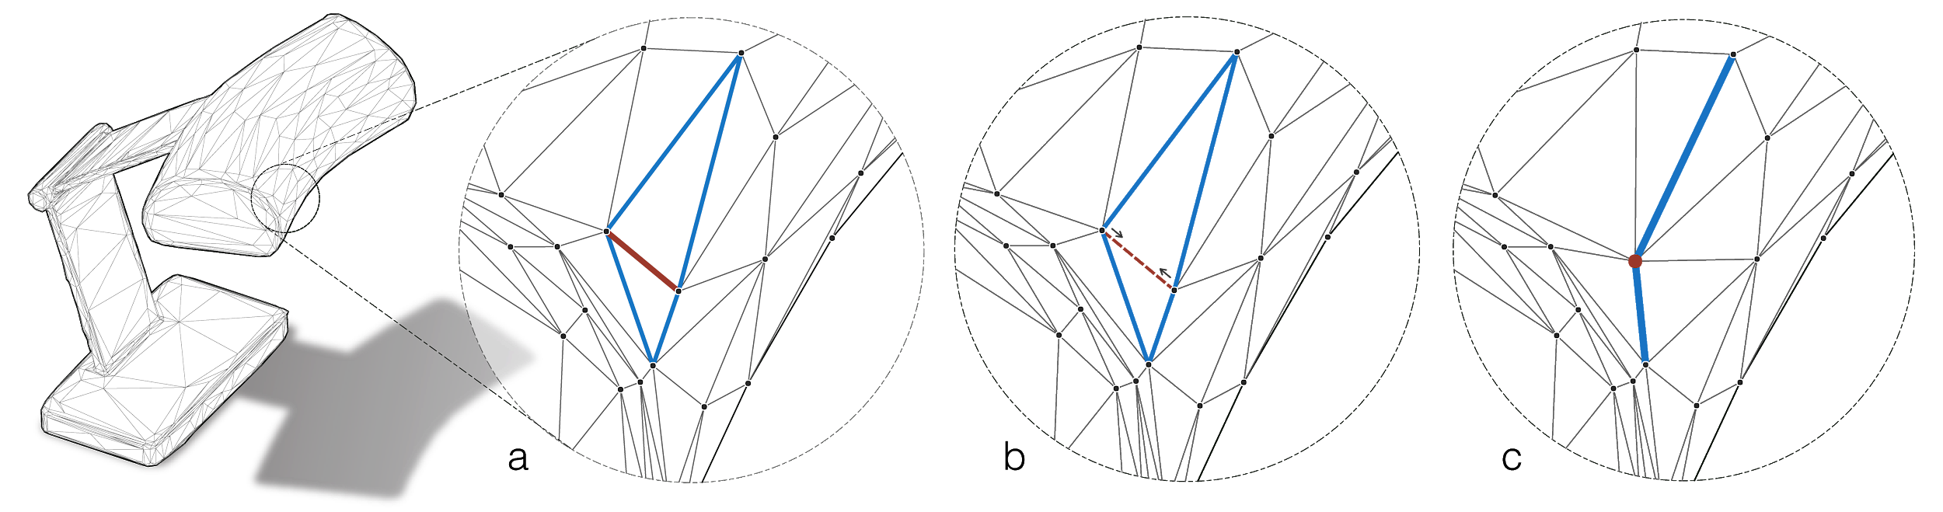
Refresher: Edge Collapse

Slide 22
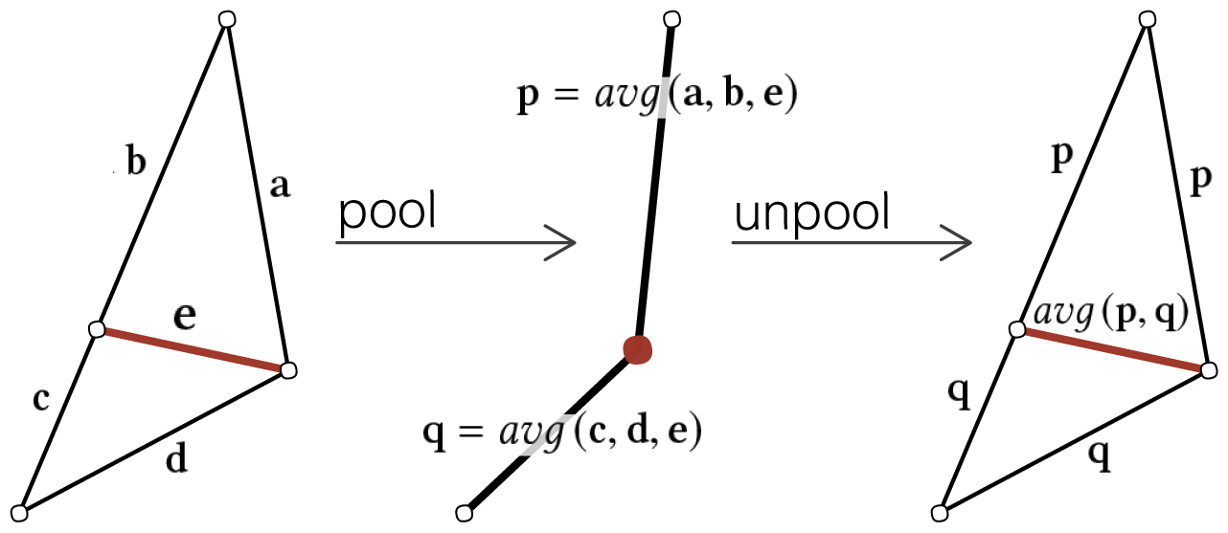
Mesh Pooling
Delete edge with smallest feature activations
Aggregate features (average pooling)
Update topology

Slide 23
Merge Edge Features
Average pooling aggregation
5 edges to 2 edges
Average per-channel

Slide 24
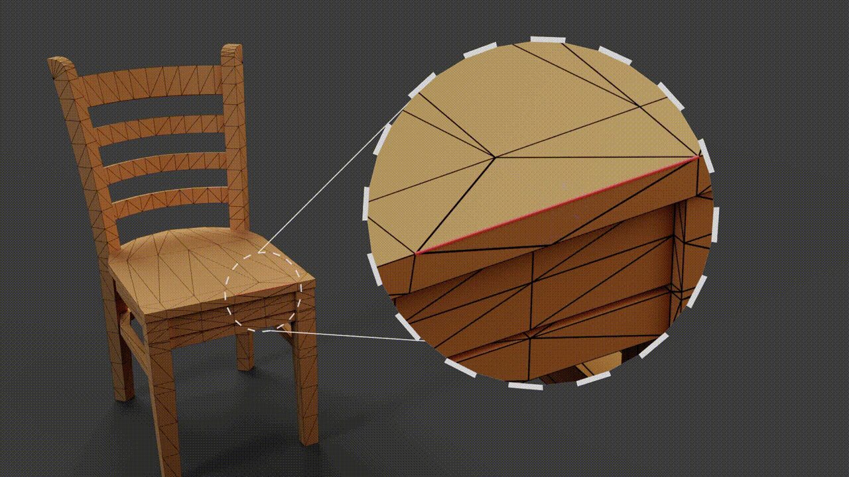
Update Mesh Topology
New mesh is generated
Defines new neighbors in next convolution
Update relevant data structures

Slide 25
Mesh Unpooling
Partial Inverse of Pooling
Restores upsampled topology (reversible)
Unpooled features weighted combination of pooled features
Notes:
The unpooling layer reinstates the upsampled topology (prior to mesh pooling),
by storing the connectivity prior to pooling. Note that upsampling
the connectivity is a reversible operation (just as in images).

Slide 26

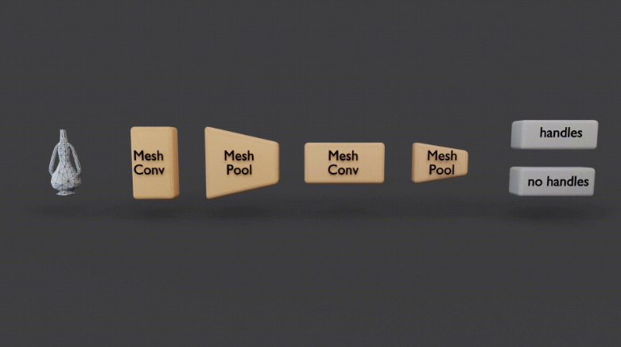
Putting the pieces together

Slide 27
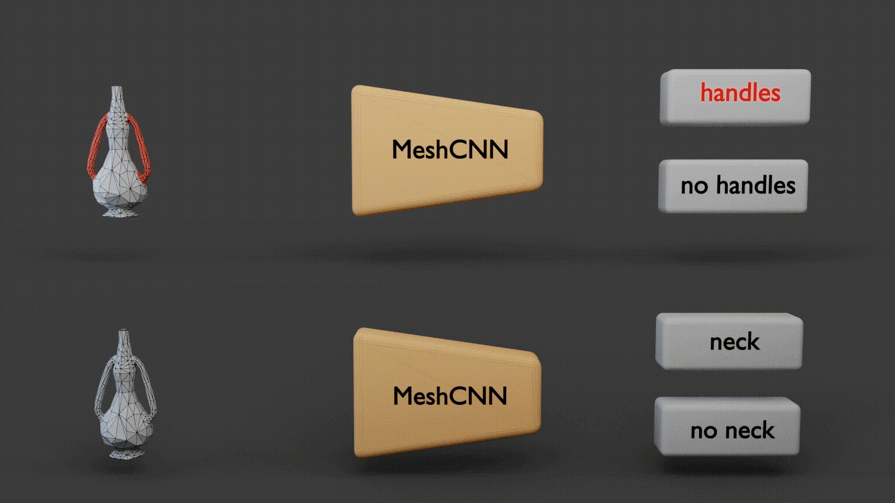
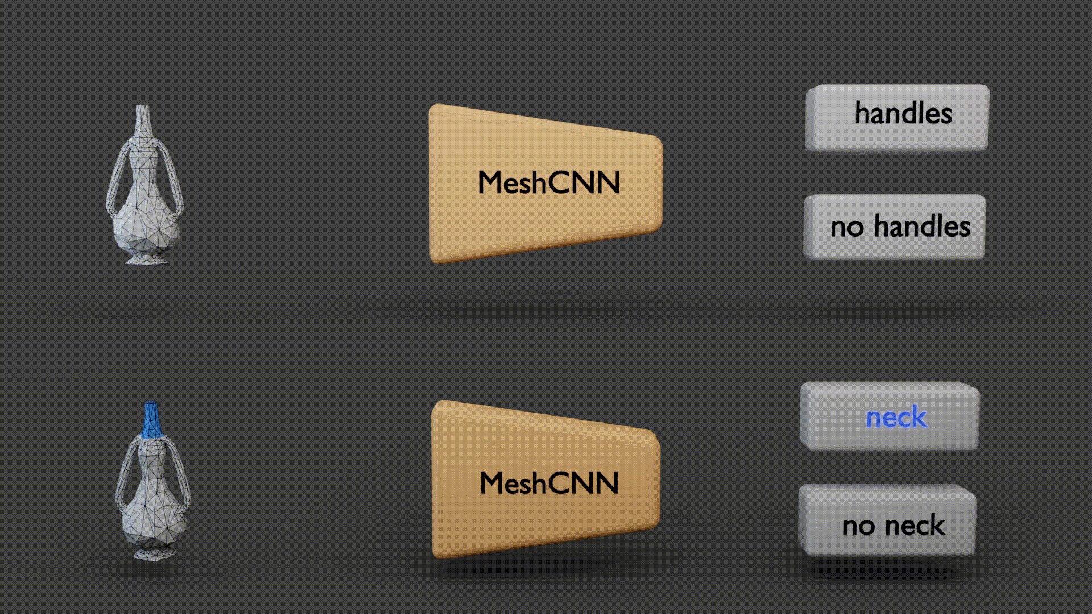
Different Tasks
Different Simplifications
Notes:
Pooling reduces the feature representation by learning to throw away redundant or non-informative features, which are specific to the task.
For example, say, we train one network to classify whether vases have handles, and another to classify whether there is a neck.
The mesh poolings or simplifications will be different, since the network chooses which shape attributes to focus on.
Mesh pooling allows us to visualize what the network learned.

Slide 28
Key Attributes of Mesh Pooling
Spatially adapts to the task
Flexible input mesh resolution
Strengthens feature representation
Visual insights from the network

Slide 29
Applications of MeshCNN
3

Slide 30
3D Deep Learning Tasks
Classification
Conv & Pooling Layers
Fully-Connected Layers
Segmentation
Fully convolutional
Conv & Pooling & Unpooling

Slide 31
Data Processing & Augmentation
Collapse to roughly same # of edges
Augmentations
Anisotropic scaling (Sx,Sy,Sz)
Vertex perturbations
Edge flips
Random edge collapses

Slide 32
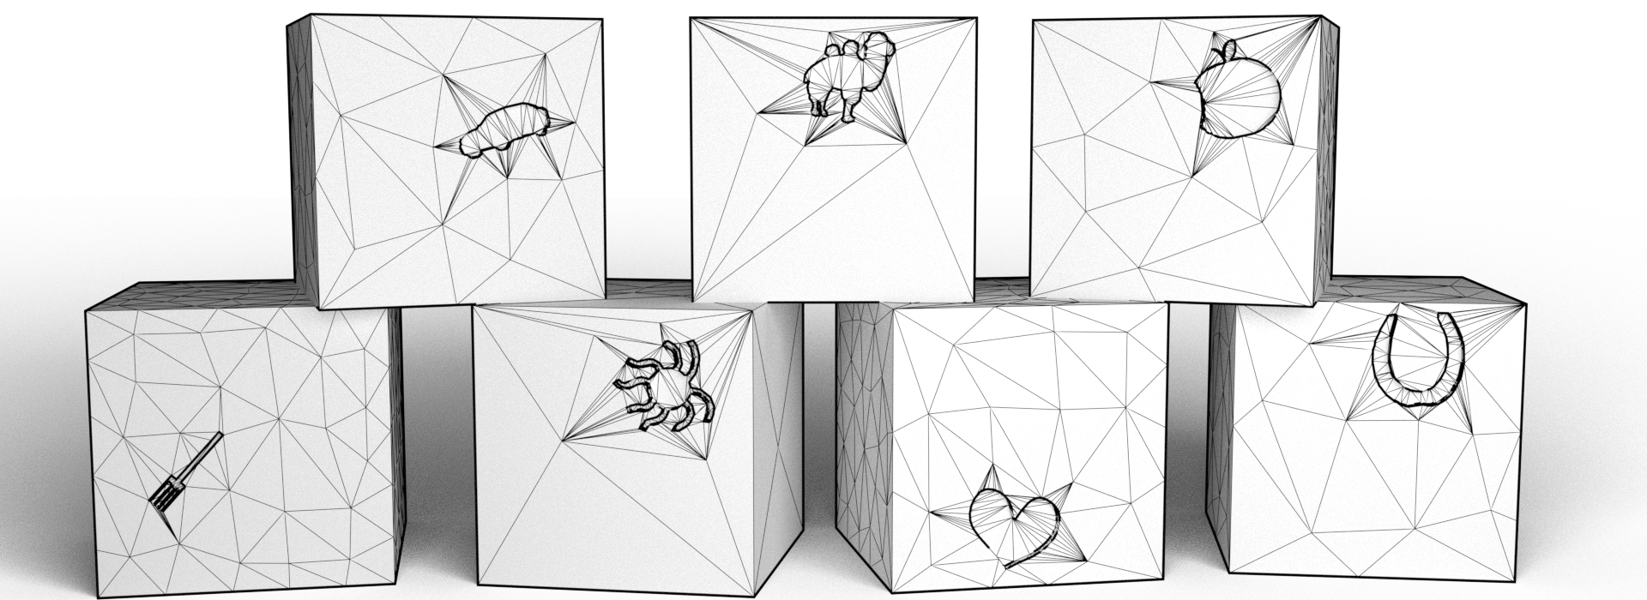
Cubes Classification
23 classes
Shallow engravings

Slide 33
Method | Resolution | Test Accuracy
MeshCNN | 750 | 92.16
PointNet++ (normals) | 4096 | 64.26
Cubes Classification

Slide 34
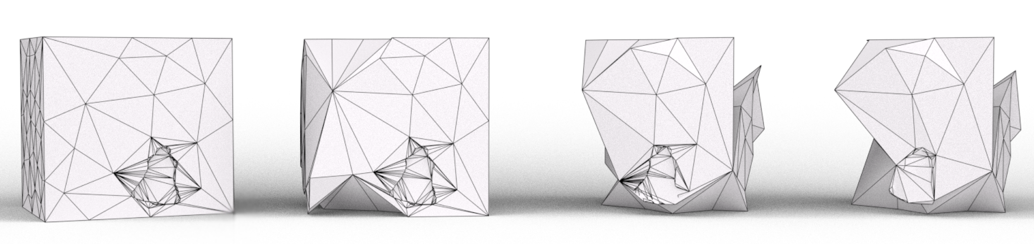
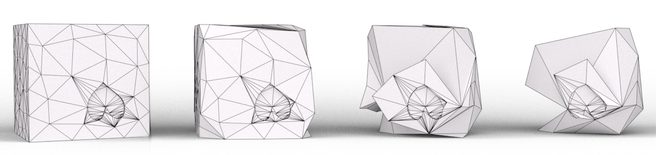
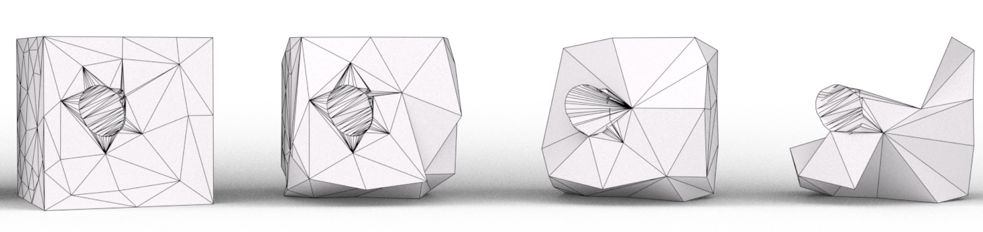
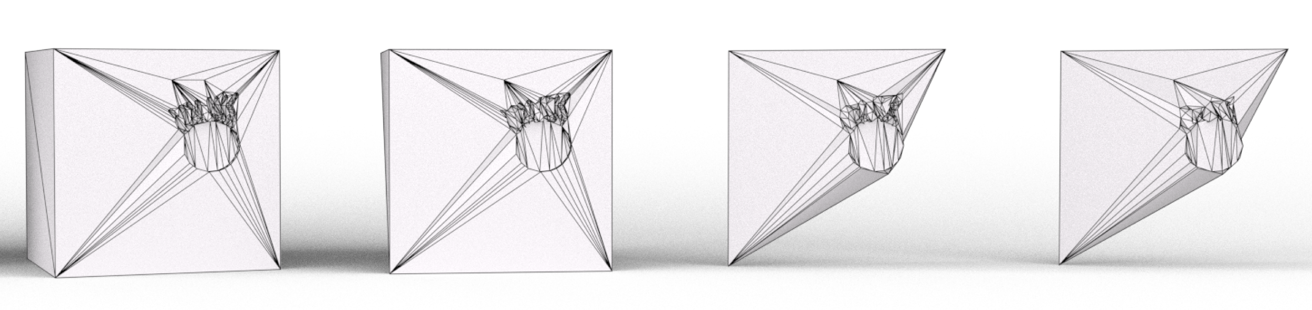

Slide 35
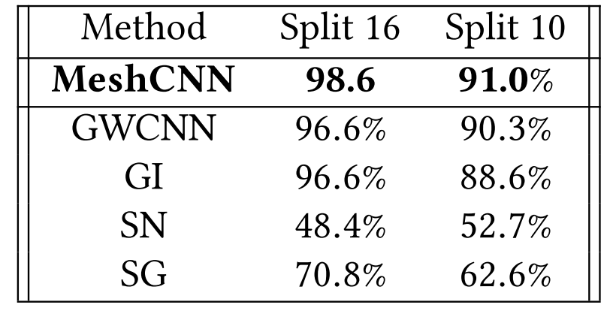
SHREC Classification

Slide 36
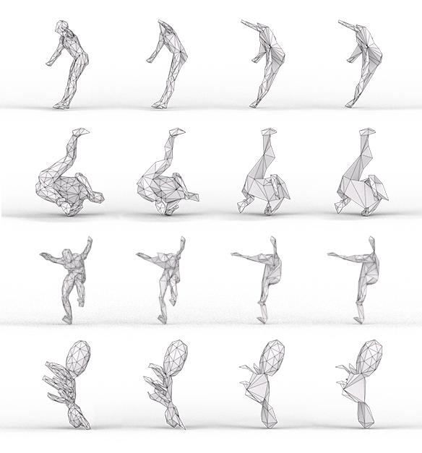
SHREC Classification

Slide 37
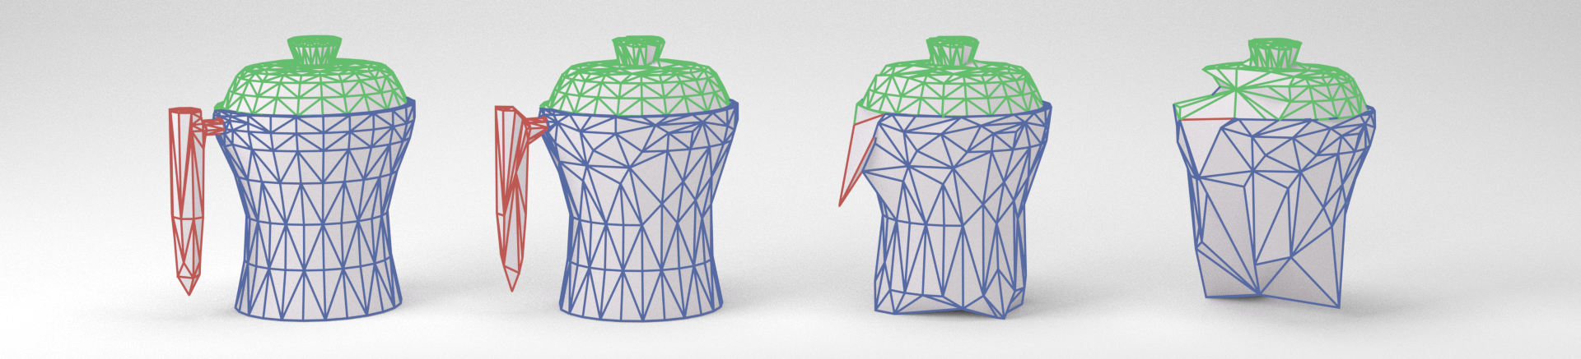
Segmentation

Slide 38
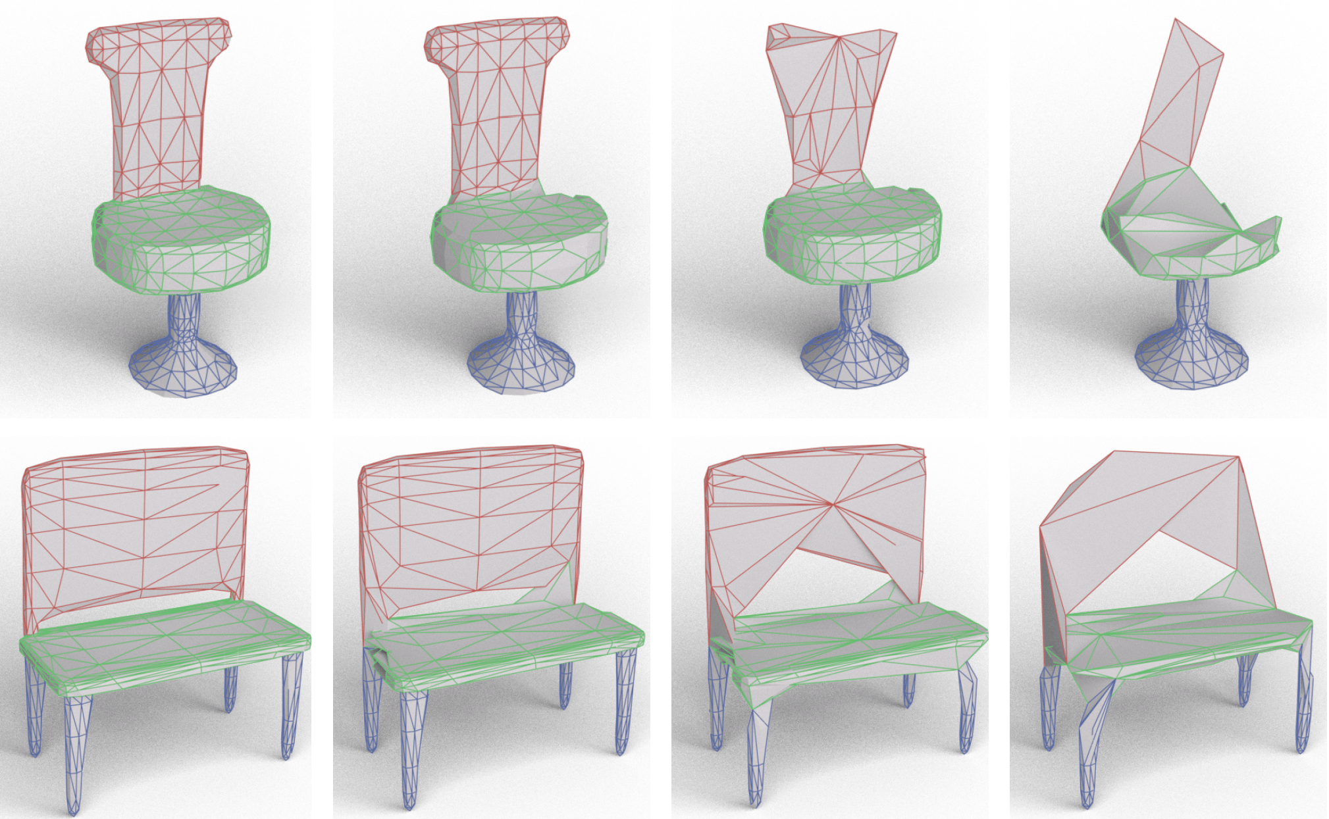
Semantic Simplification

Slide 39
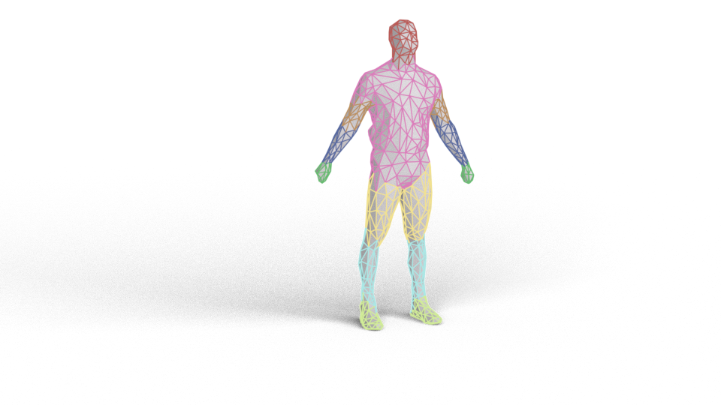
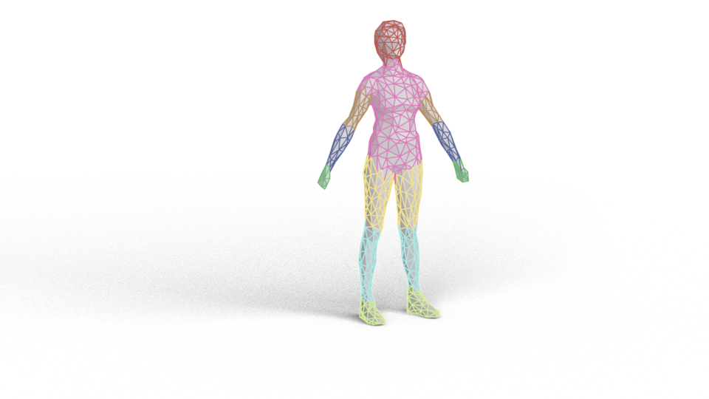
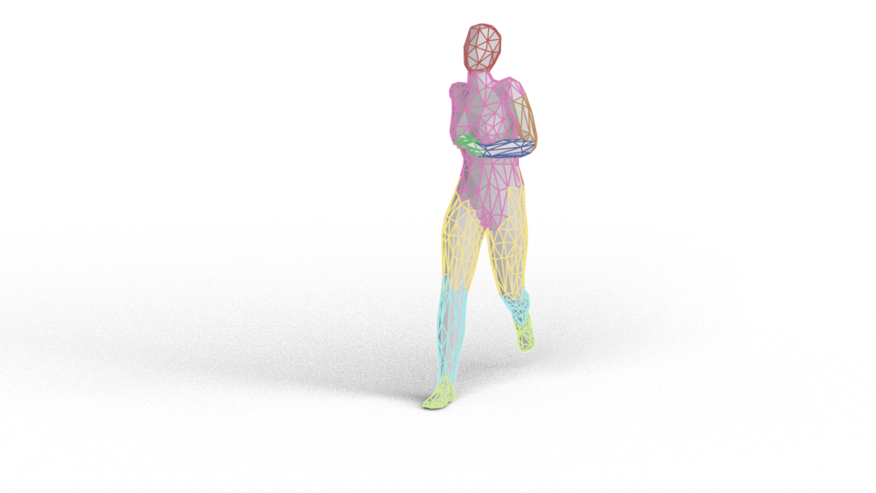
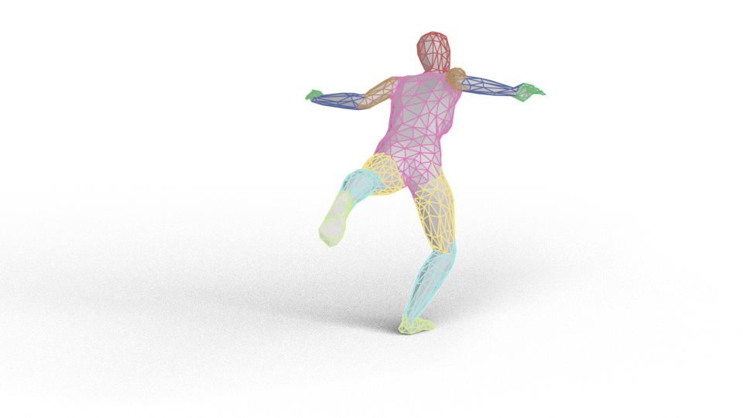
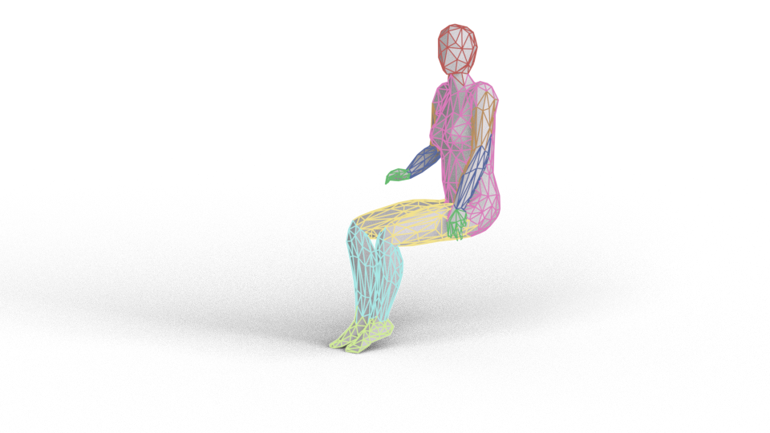
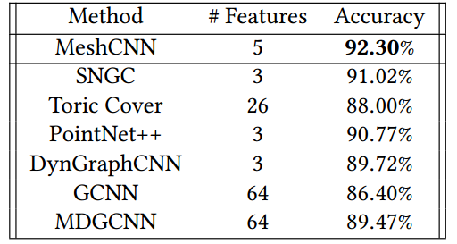
Human Segmentation

Slide 40
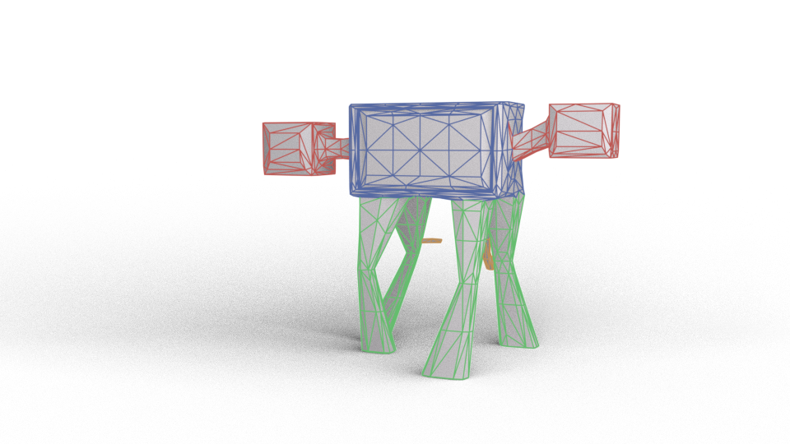

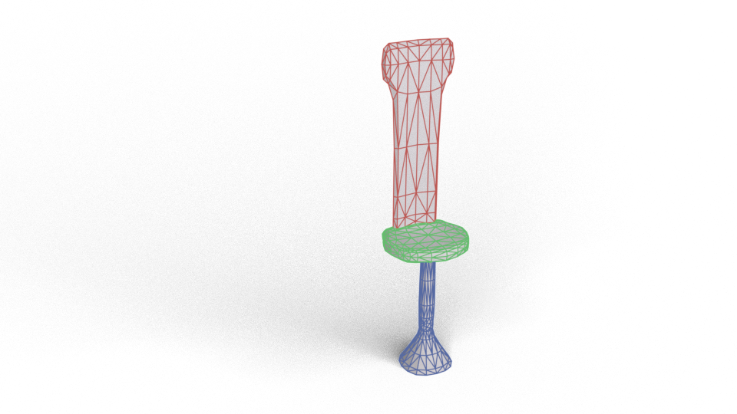
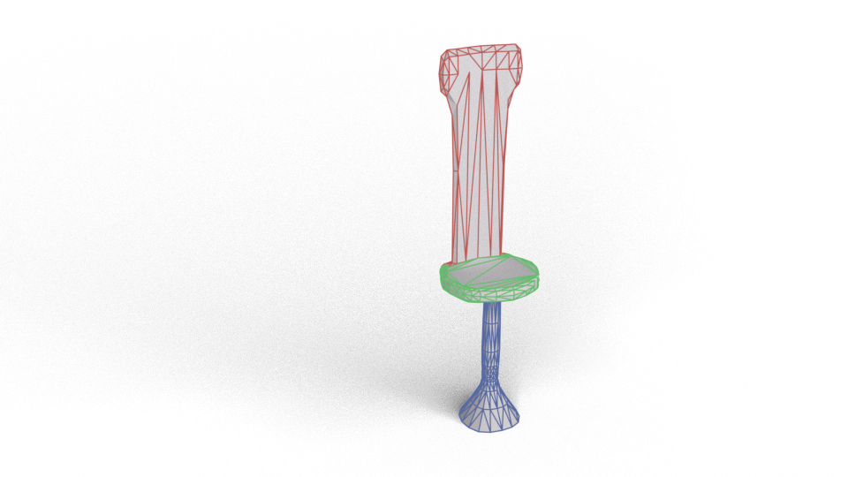
Triangulation Robustness

Slide 41
Insights & Take Home Messages
4

Slide 42
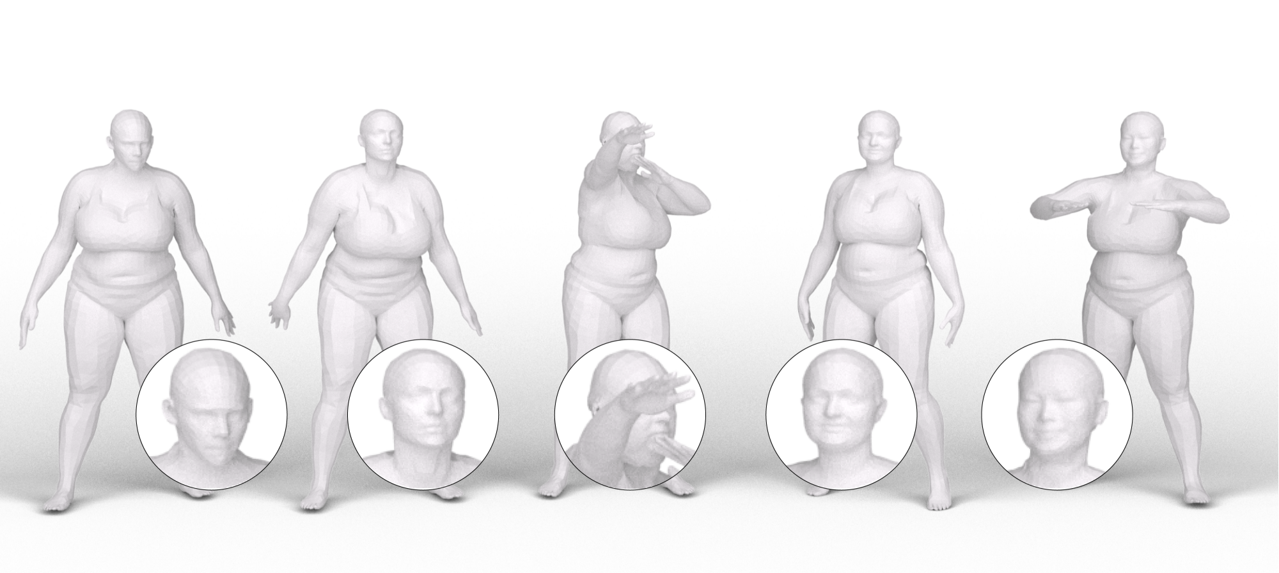
Head Swap Classification

Slide 43
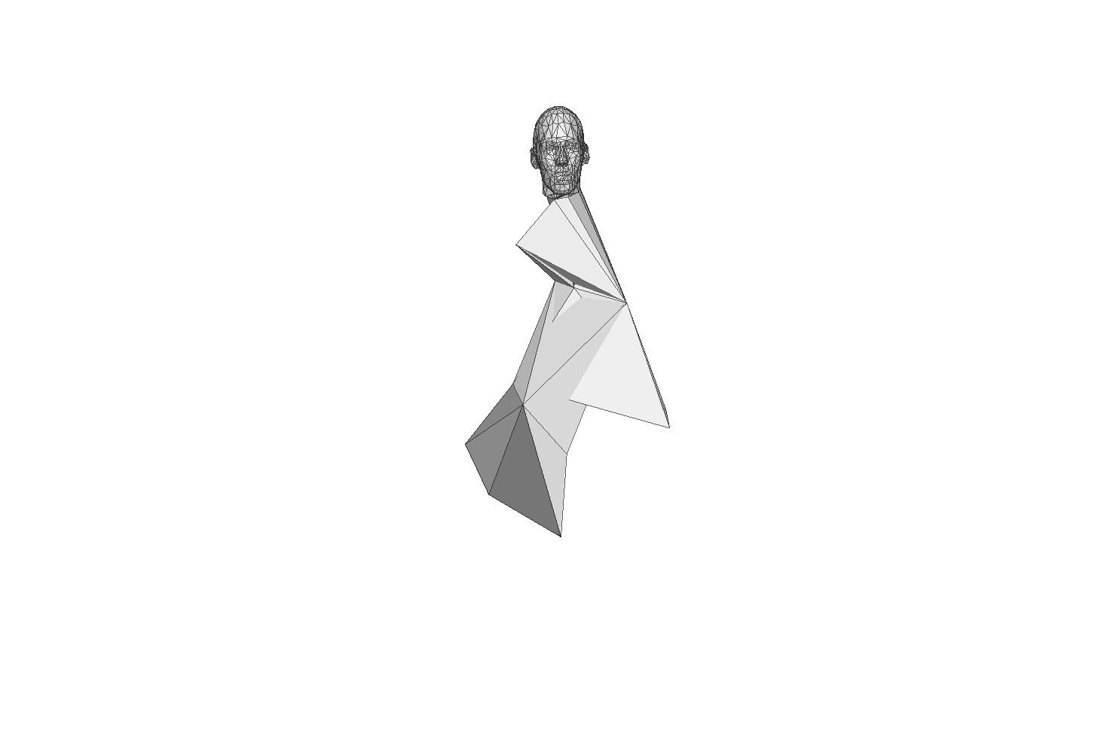




Network learned something else!

Slide 44



What the network learned
Input vase
XYZ coordinates
MeshCNN features

Slide 45
Conclusions
Invariant Convolutions
Invariant to similarity transformations
Relative Geometric Features
Spatially Adaptive Pooling
Task driven edge collapse
Strengthens the learned representation
Visual cues & insights into network behavior
Future Works
Generative models
Graphs

Slide 46

Thanks!
Any questions ?
You can find me at
hanocka.com
rana@hanocka.com

